Slide 1


Snakegame
with 30 LEDs Charlyplexing methode

Slide 2
Interne snakegame workshops
Ma 5 juli; Uitleg HW & solderen -> Roland
Ma 19 juli; Uitleg SW principe
& Arduino IDE -> Jacko
Ma 2 aug; Zelf applicatie maken &
Nadenken hoe externe workshops
Notes:
Uitleg schema

Slide 3
Snakegame HW
Items:
Bare Arduino
Leds control; Charlyplexing
Buttons & Piezo speaker
Programming interfaces
ICSP; in-circuit serial programming Used for programming bootloader
Serial ; Needs a FTDI USB->TTL board Used for uploading sketches
Power Supply
PCB
Notes:
Uitleg schema

Slide 4
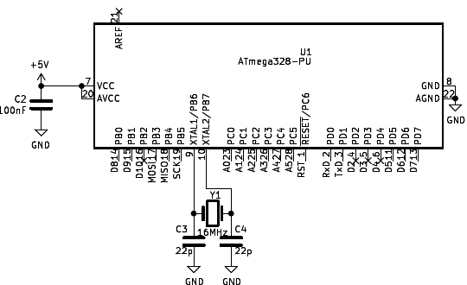
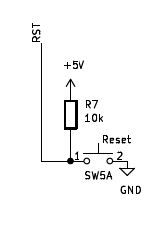
Bare Arduino

Slide 5
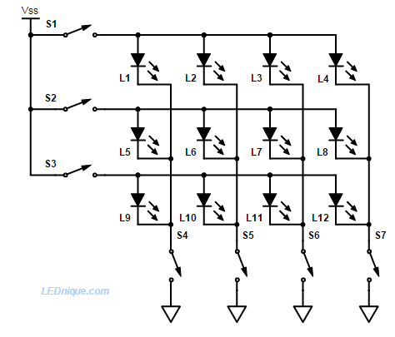
Multiplexed LED matrix

Slide 6
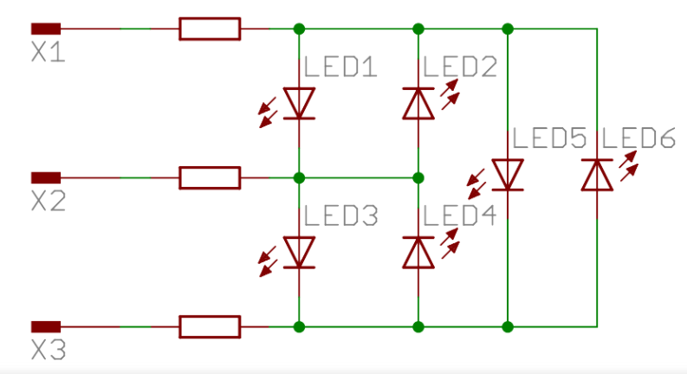
Charlyplexed LED matrix
See; Charlyplexing LED matrix
#Leds = N*(N-1)

Slide 7
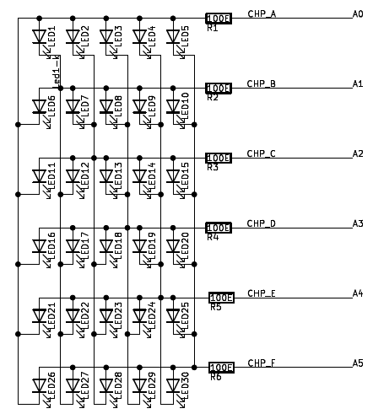
Charlyplexed LED matrix

Slide 8
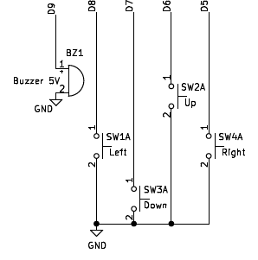
Buttons & Piezo speaker

Slide 9
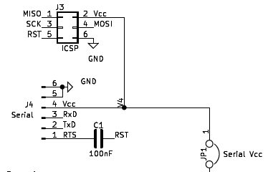
Programming Interfaces

Slide 10
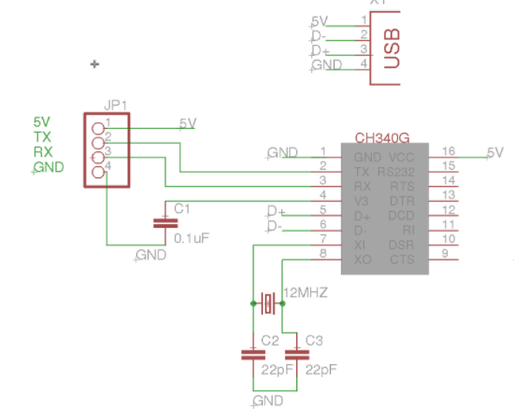
External FTDI Board

Slide 11
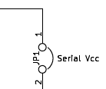
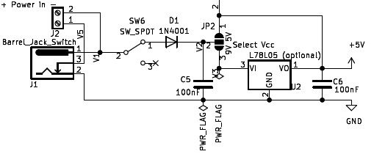
Power supply

Slide 12
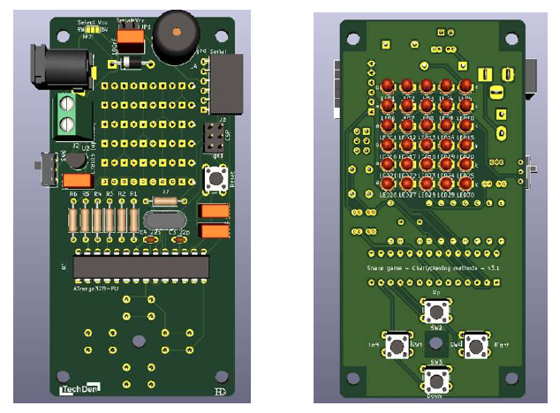
PCB

Slide 13
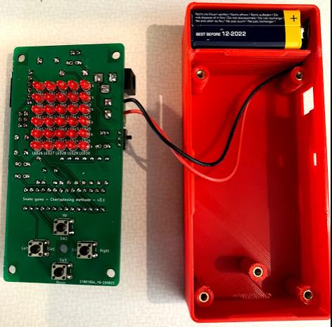
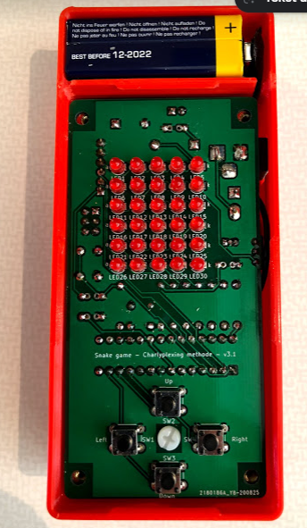
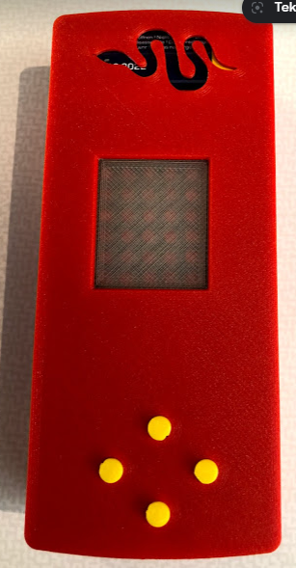
Case voorbeeld
Demo

Slide 14
Check
LEDs & 4 Buttons op achterzijde van PCB!!
Polariteit leds & diode
Positie ATMEGA328
Jumpers Power supply
Positie FTDI boardje
ATMEGA328 is reeds voorzien van bootloader & DEMO sketch

